Slide 1
Napkin Pitch: Redesigning the Grocery Shopping Experience
A Design Thinking Case Study

Slide 2
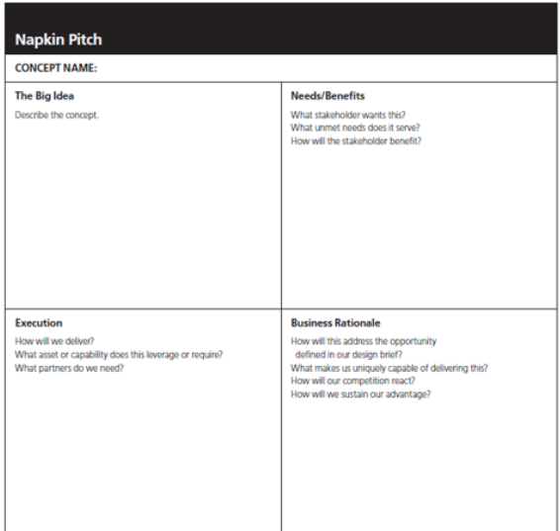

Slide 3
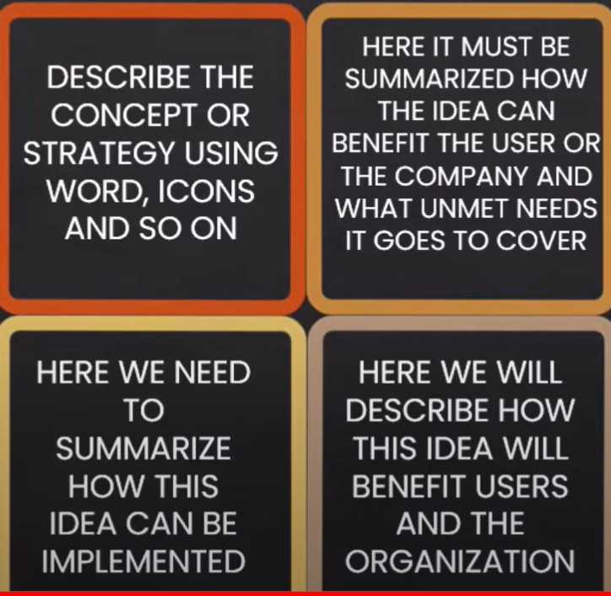

Slide 4
Problem Statement
Grocery shopping can be overwhelming, with challenges in navigating aisles, finding products, and long checkout lines, leading to frustration for busy shoppers.

Slide 5
Napkin Pitch
We’re redesigning the grocery shopping experience to make it faster, more efficient, and personalized. Our solution integrates a smart shopping assistant app that provides:
- Real-time aisle navigation
- Personalized product recommendations
- Seamless checkout with mobile payments
Shoppers will save time and have a smoother, more enjoyable shopping journey.

Slide 6
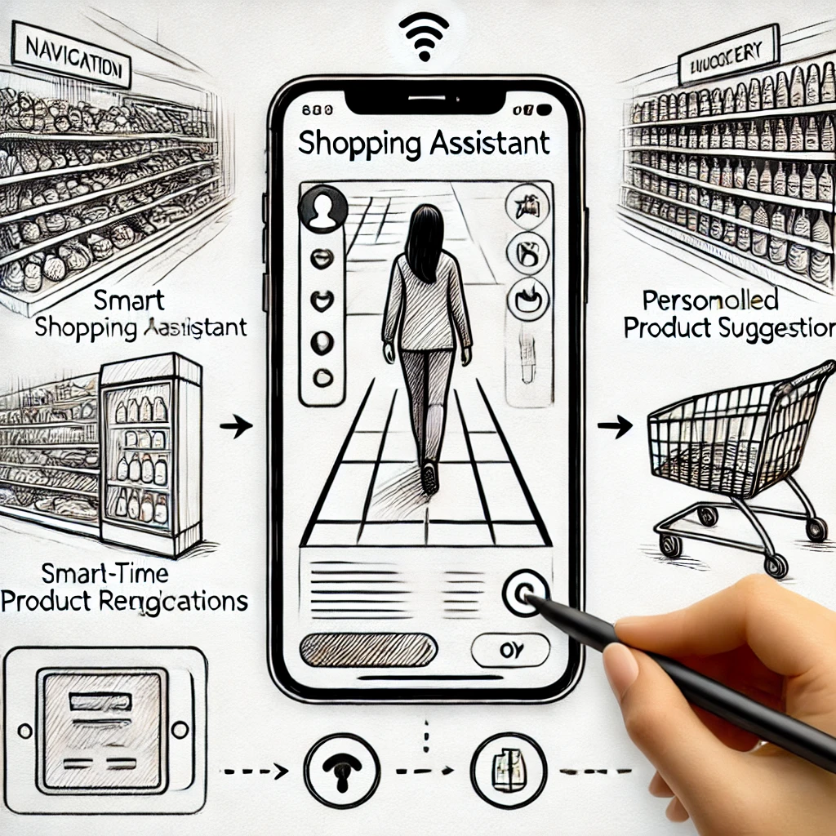
Redesign Sketch

